Slide 1
Quantum vs classical genetic algorithms
A comparison between quantum and classical neural networks through the lens of a genetic algorithm simulation.

Slide 2

Genetic Algorithms
A genetic algorithm is an optimization technique which replicates better performing versions of an algorithm (with some deviation or mutation) and removes worse performing versions.
The genetic algorithm used for this project is a predator/prey algorithm, where each predator learns (through the genetic algorithm) how to move around and look for food.
Predators are allowed to reproduce (with random mutations) if they have eaten enough food and they die if they have not eat enough.
Prey randomly appear in blobs and are immobile.
1 Iteration of Genetic Algorithm
AlgorithmA
Version 1
AlgorithmA
Version 1a
AlgorithmA
Version 1b
AlgorithmA
Version 2

Slide 3
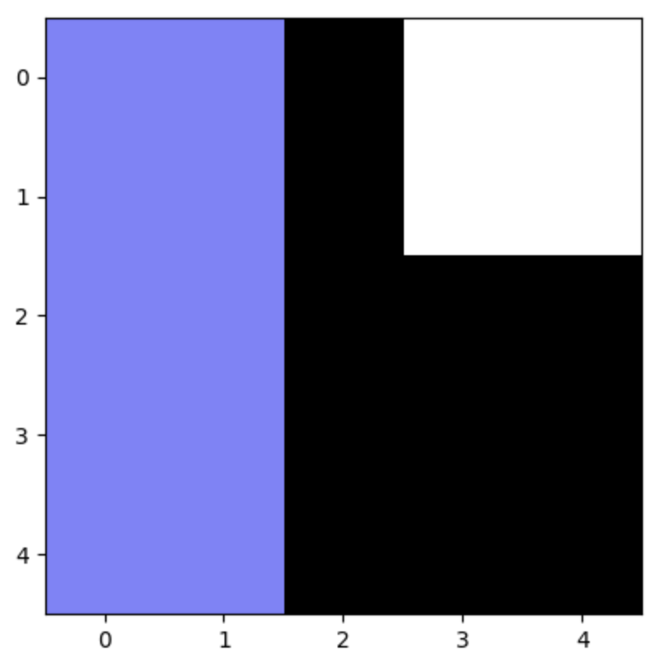
The predators
Each predator takes as input their surroundings and outputs one of three options: 1) move forward, 2)turn left and move forward, or 3)turn right and move forward.
The main format for each predator’s decision is a neural network. The neural network takes as input a flattened field of view, which is a nxn grid of the surroundings closest to the predator. The network outputs 3 nodes, each corresponding to one of the above choices. The structure of the network is a feed forward network as follows:
1
Move decided on is the maximum node option (in this case option 1, move forward
2
3
Field of view where white is food, black is blank space, and purple is off the map

Slide 4

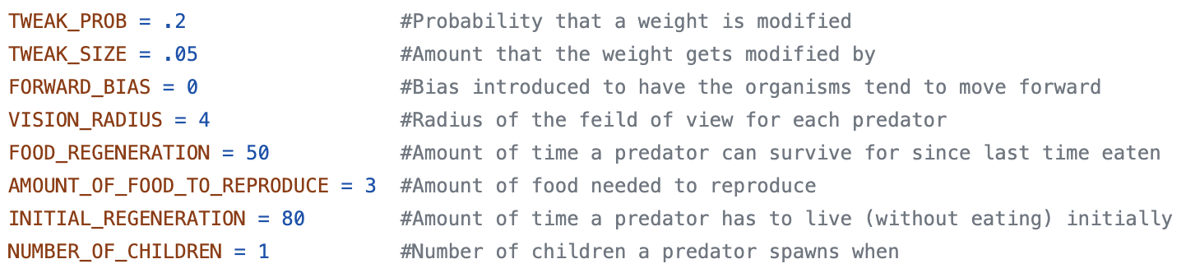
Predator Evolution
When a predator duplicates, the weights of its neural network are copied over with some slight mutation. In this case, mutation means that for some probability parameter, P, and some width parameter, d, each gene has a ”P” chance of being added to a random number generated from a normal distribution of width ”d.”
There are other parameters which change and adjust the way predator evolve. They are

Slide 5
Quantum Predators
Quantum predators are generated using hybrid quantum neural networks. These hybrid quantum neural networks have a classical part which feeds into a series of quantum circuits. Then, each quantum circuit outputs a measurement in the form of a series of outputs and frequencies associated with those outputs.
In some sense, this can be thought of as a classical network “tickling” quantum circuits.
Weighted average measurement
Quantum Circuit
1
Quantum Circuit
2
Quantum Circuit
3

Slide 6


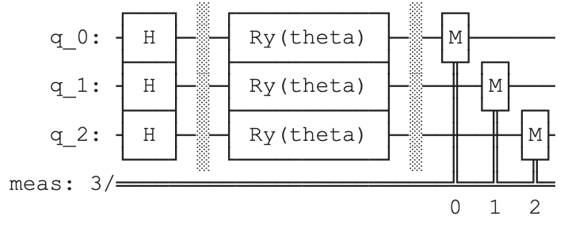
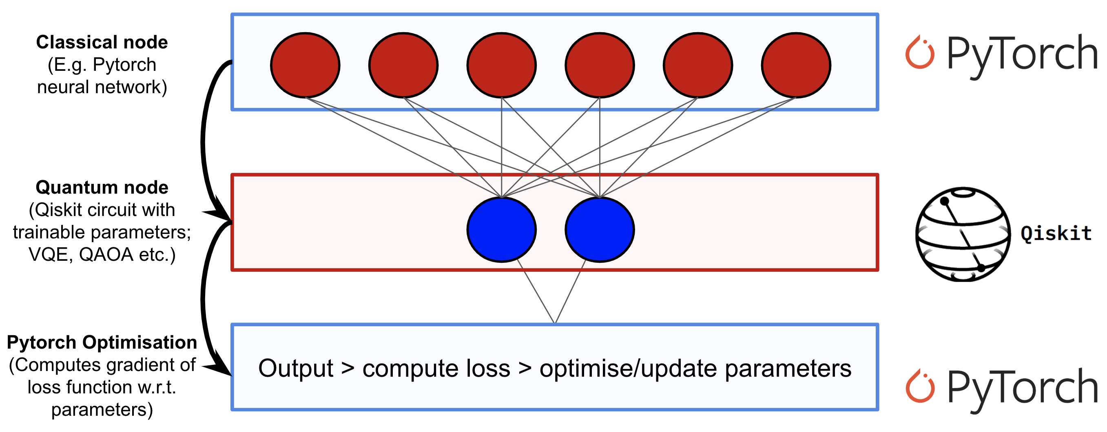
Quantum Circuits and motivation
The quantum circuit used for this project can be seen on the right. The classical inputs are the values of each theta parameter and the classical outputs are the the three measurements taken.
Quantum circuits used in these contexts often must remain small due to backpropagation limitations imposed by classical training of neural networks. However, genetic algorithms do not need to classically train networks and are heavily parallelizable, thus the quantum circuits may become significantly larger. Here, the quantum circuit size is limited by processor core availability.
Motivation for this kind of quantum circuit comes from the nature of rotations of q-bits. The Hadamard induces a ”+” state which can be easily rotated by the Ry gates to produce a large variety of entangled states.

Slide 7
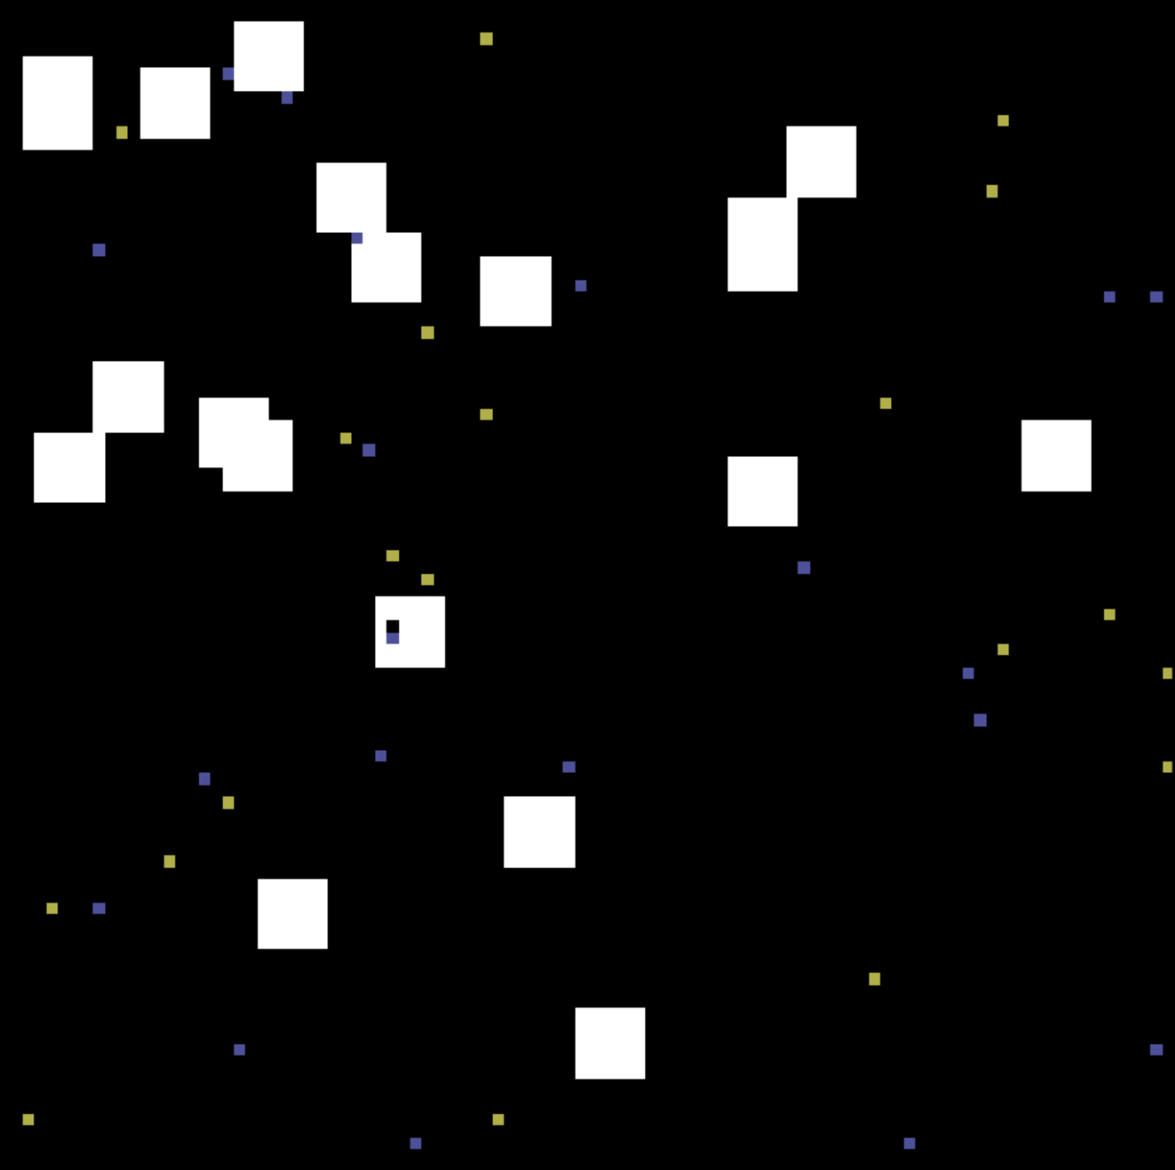
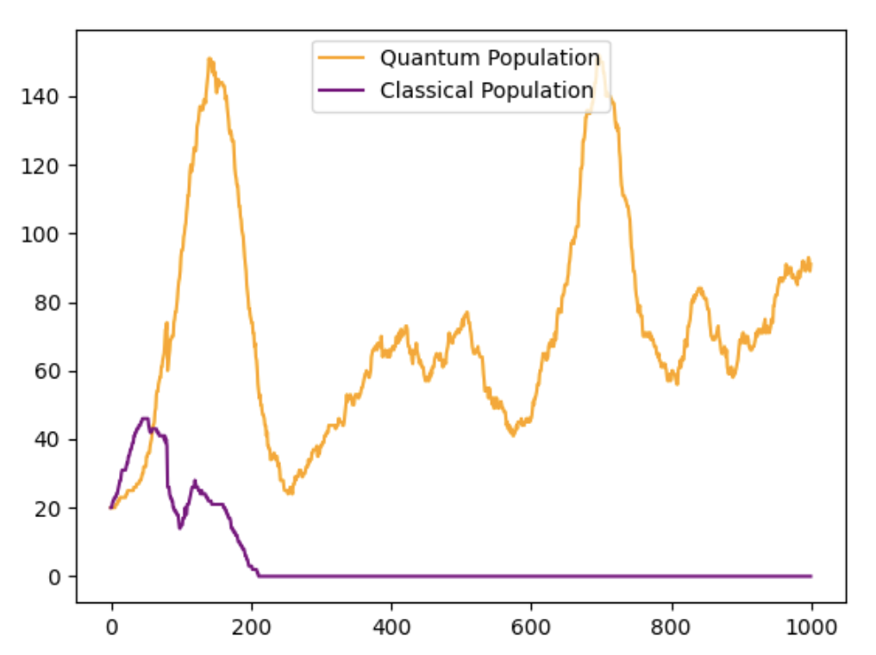
Simulations and expectations
The interest of this project is to compare classical to quantum genetic algorithms. One interesting way to see this is to launch a simulation where quantum predators compete against classical predators for limit food resources. The simulation can be seen on the left, where yellow dots are quantum predators, purple dots are classical predators, and white is food.
The prediction is that the quantum algorithms perform slightly better, as the rotation of qubits is more closely related to the rotation of the rotation of the predator. However, quantum predators may be slower to evolve due to difficulties in evolving the quantum circuit’s parameters.

Slide 8
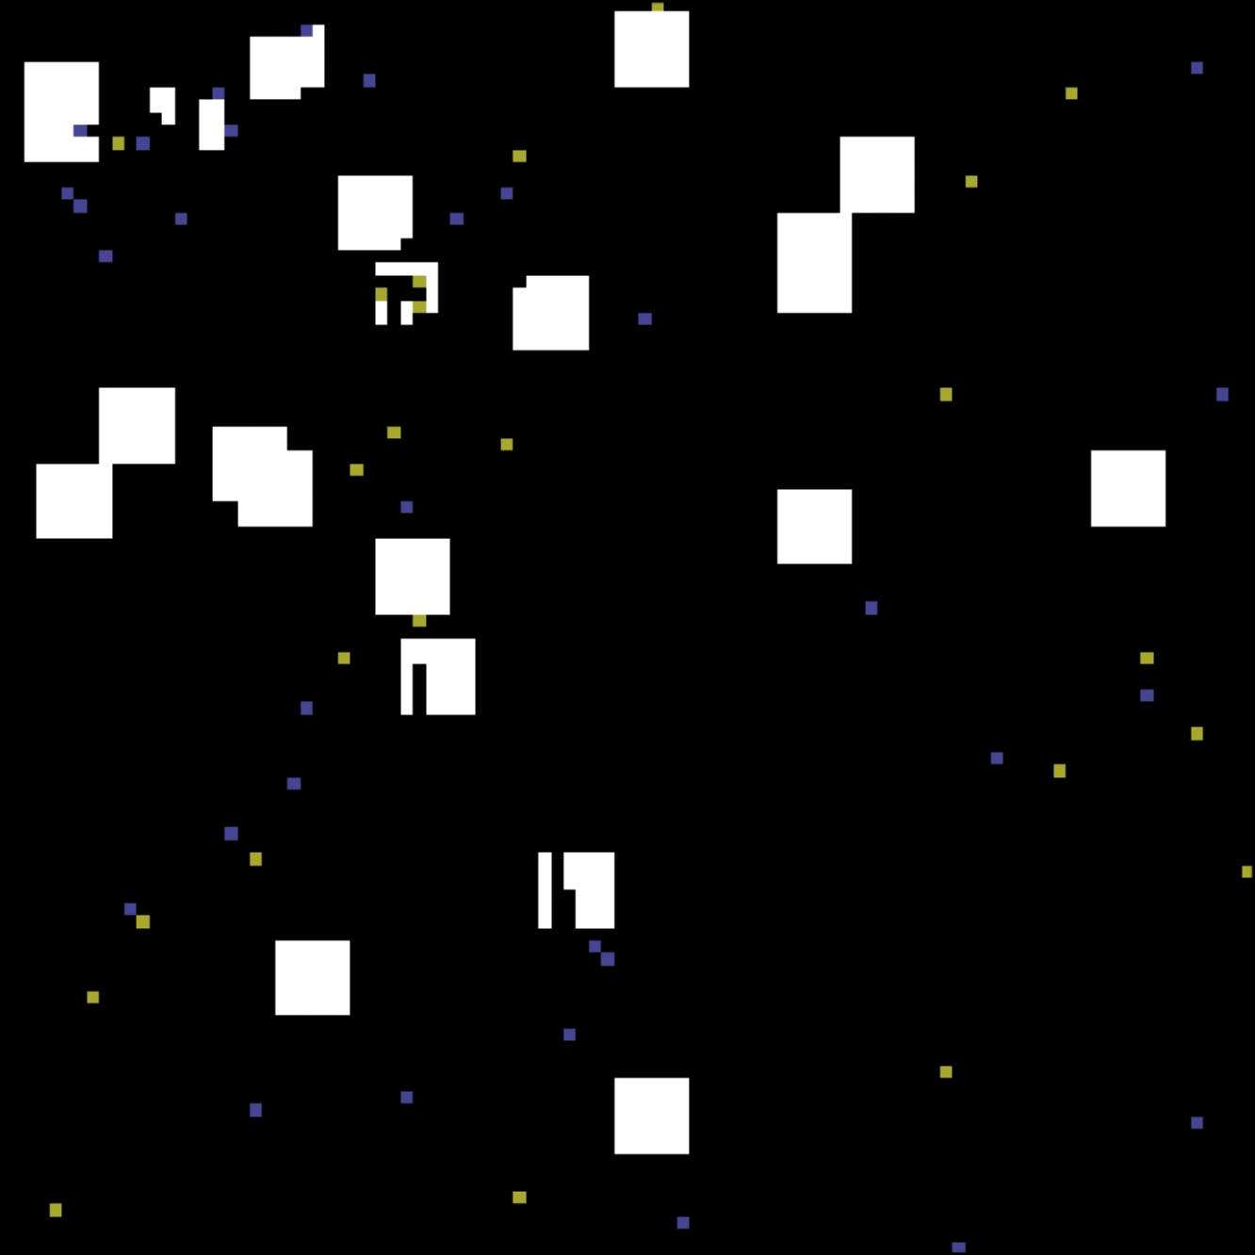
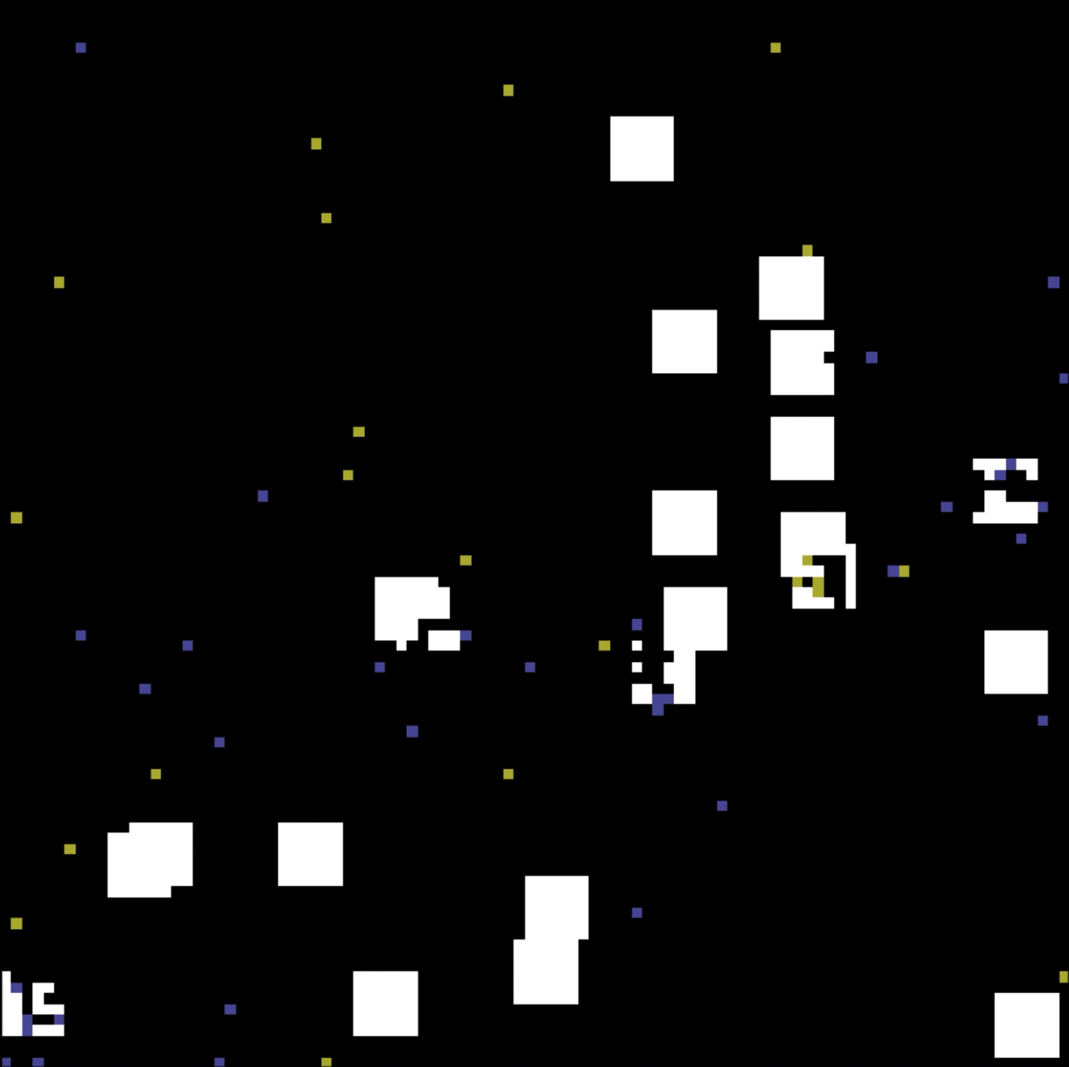
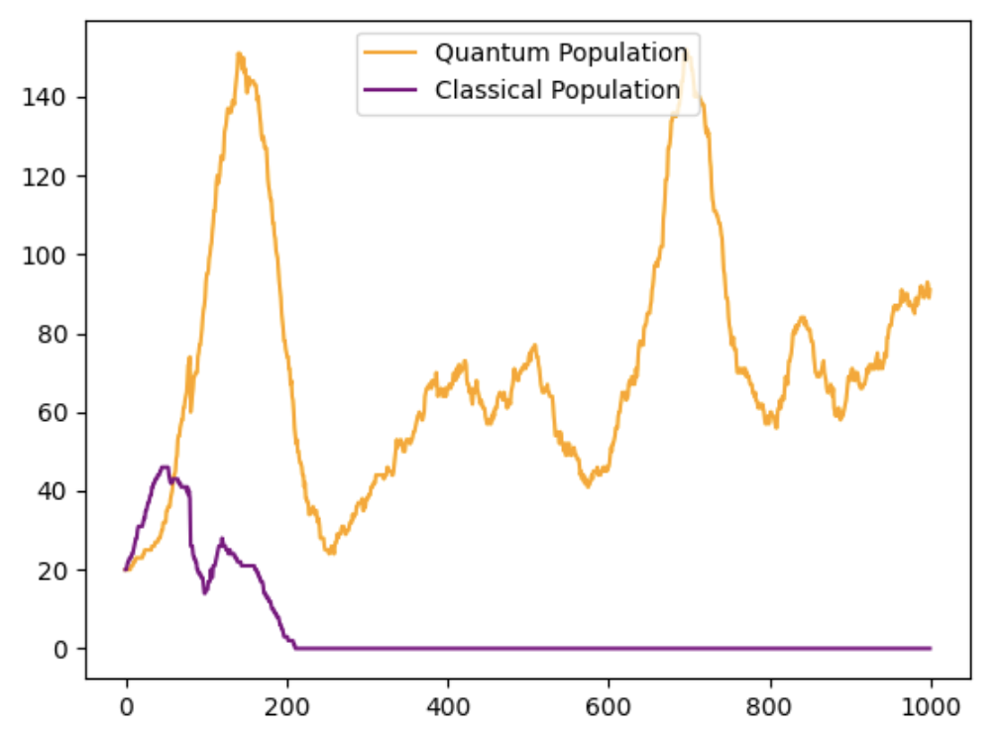
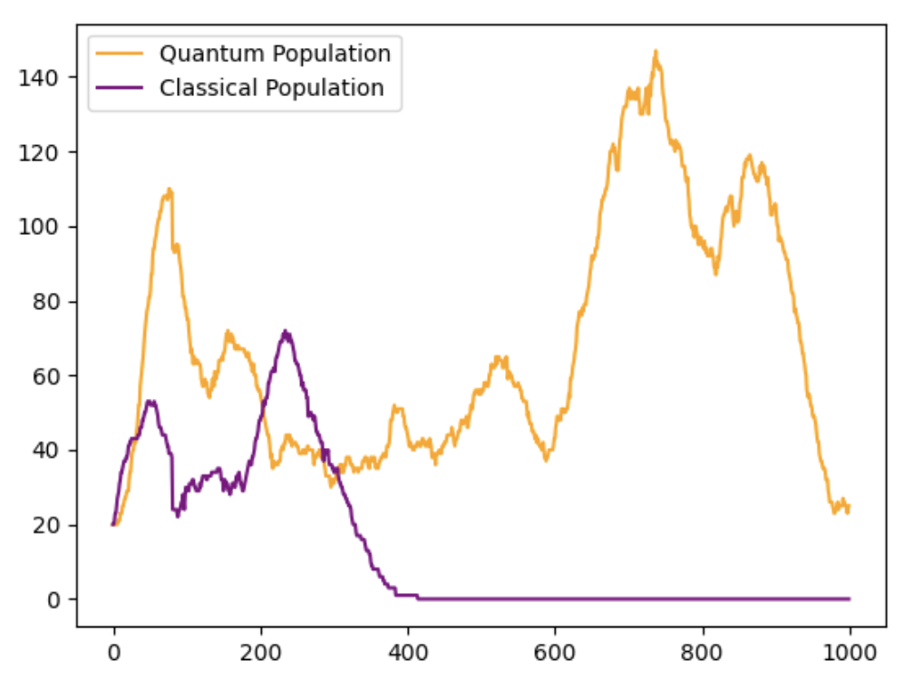
Results
Two animations and corresponding population graphs, each seeded at a different random seed.
More results can be found here:
https://github.com/julius-heitkoetter/genetic_quantum_algorithm/tree/main/sample_outputs

Slide 9
Conclusions and improvements
Overall, the predators seem to evolve towards being able to eat the food at a better rate. Most of the simulations show predators learning to sprint forward when there is no food around and collect food in a circular pattern once they get to it.
Populations tend to fluctuate up and down, due to fluctuations in food availability. However, overall there appears to be a trend upward in some simulations (including the left one on the previous slide).
Most of the simulations show quantum domination. However, the classical predators do out-compete the quantum sometimes.
Further analysis can be done to optimize both kinds of predators (including building better quantum circuits) and adding in sophistications to the simulation (such as moving prey)

Slide 10
Thanks for your time!
Sources:
King, J. (2019, July 2). Quantum-Assisted Genetic Algorithm. Retrieved February 3, 2023, from https://arxiv.org/pdf/1907.00707.pdf
Team, T. Q. (2022, November 29). Hybrid quantum-classical neural networks with Pytorch and Qiskit. qiskit.org. Retrieved February 3, 2023, from https://qiskit.org/textbook/ch-machine-learning/machine-learning-qiskit-pytorch.html
Github Repo:
https://github.com/julius-heitkoetter/genetic_quantum_algorithm

